Slide 1

DeepskyLog
Online application to prepare and log deep-sky observations
RACA starparty
9 - 12 May 2013

Slide 2
DeepskyLog
Overview
What?
Why?
Who?
History
DeepskyLog 4.3

Slide 3
DeepskyLog - What?
Prepare
Log
Compare
Communicate
Free!
International
Tool for 'VVS Werkgroep Deep-Sky'

Slide 4

DeepskyLog - Why?
No idea which objects already observed
Other observers?
Online, nothing user-friendly was available in 2004

Slide 5
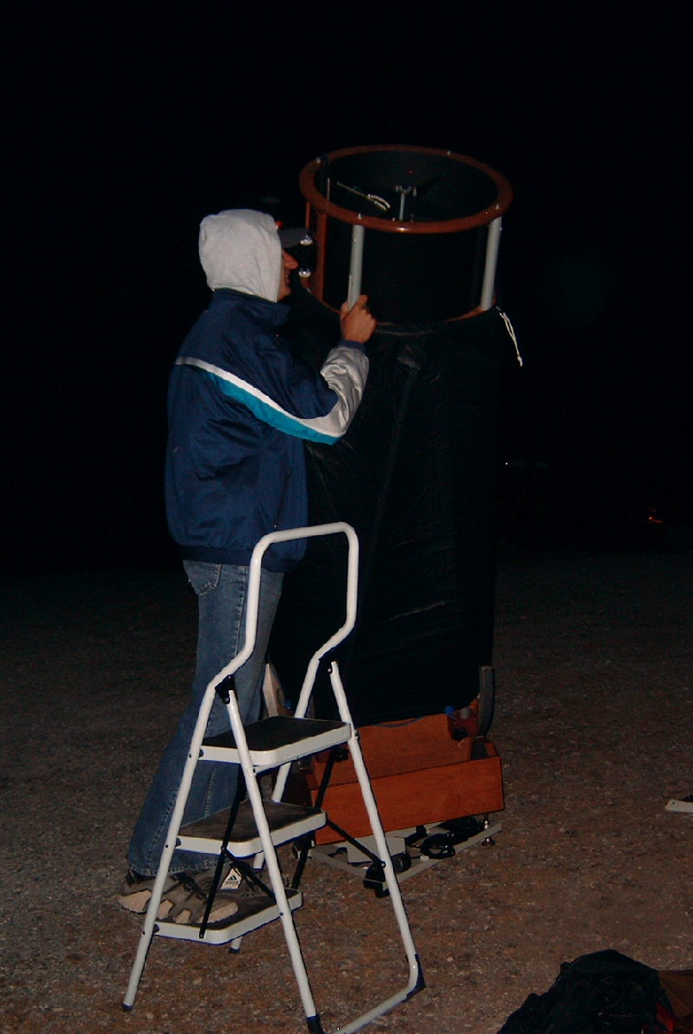
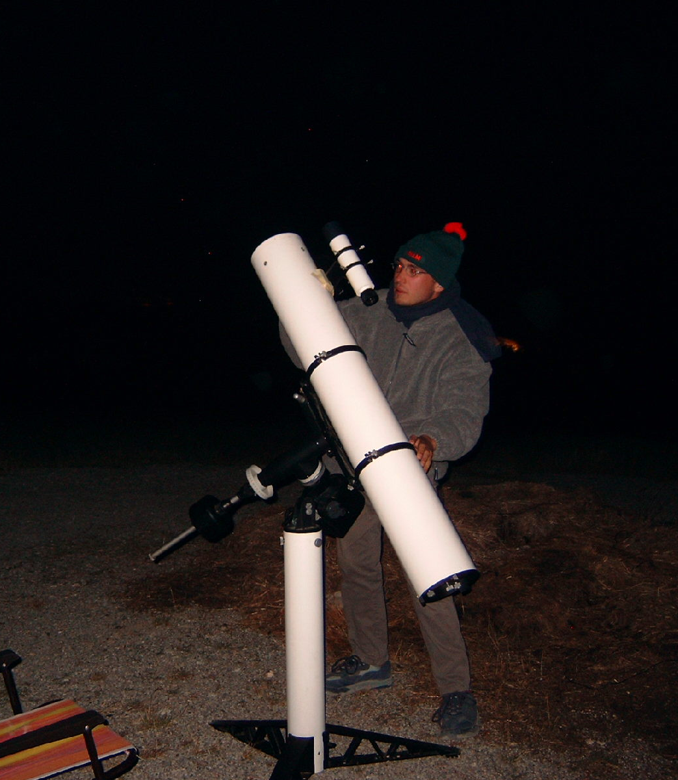
DeepskyLog - Who?
Wim De Meester
Jan Vanautgaerden

Slide 6
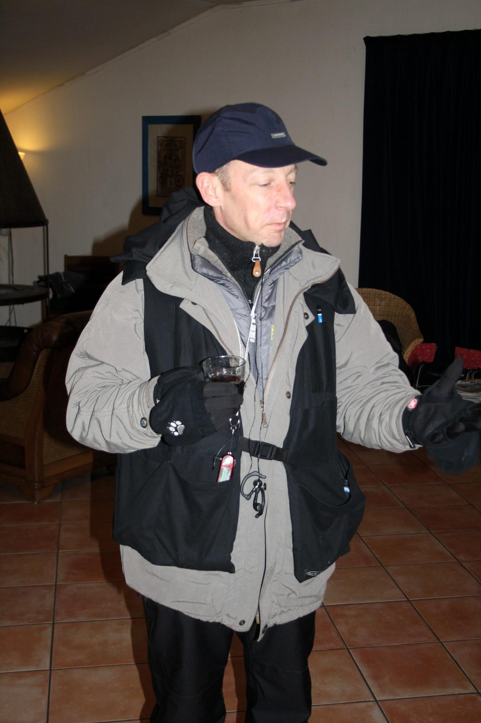
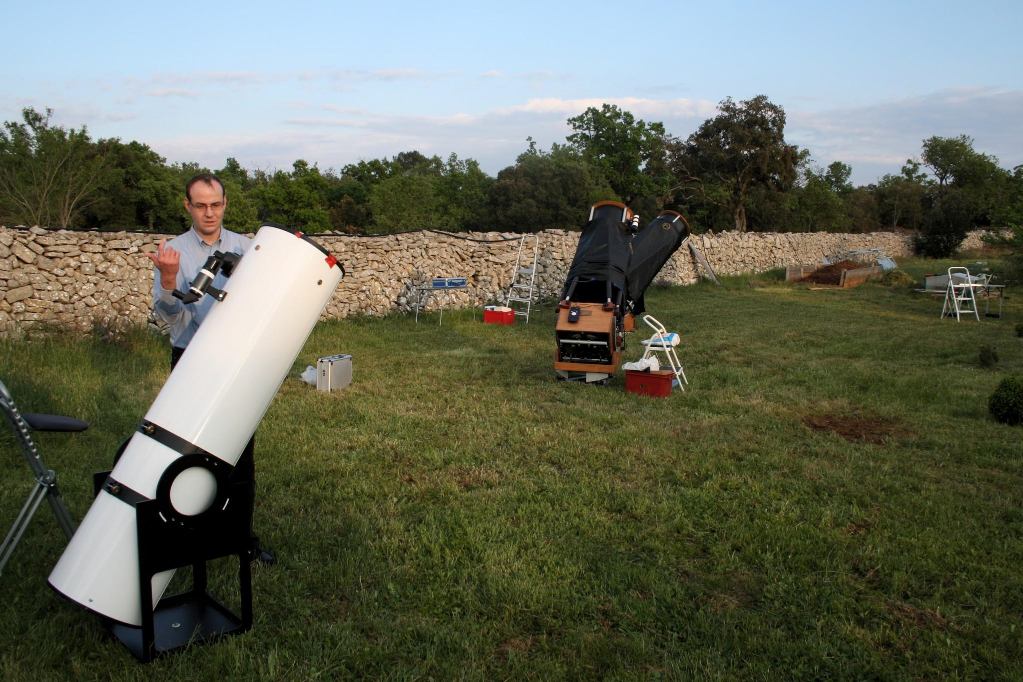
DeepskyLog - Who?
David Erzeel
Eric Van der Jeught

Slide 7
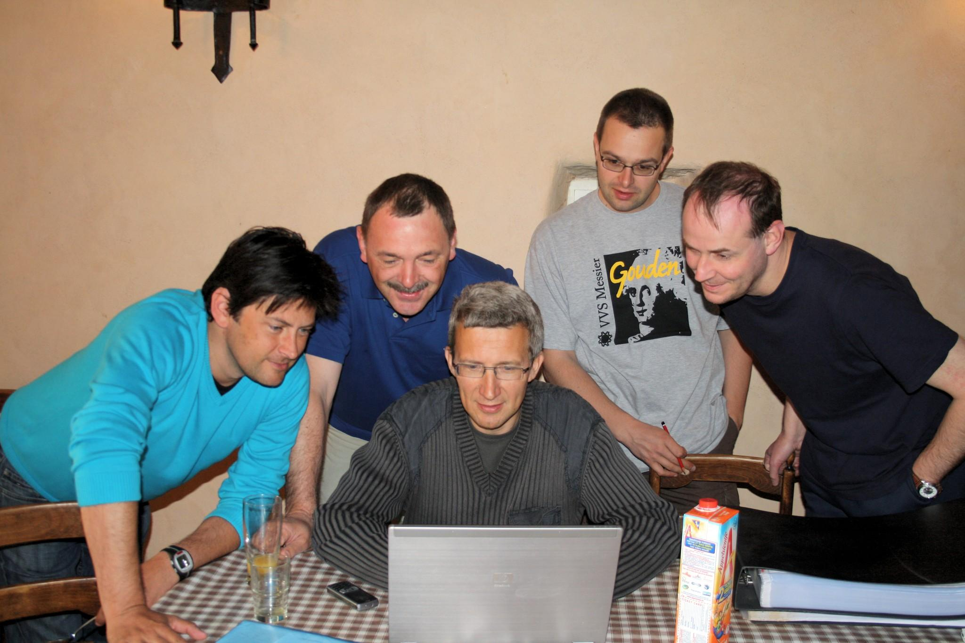
DeepskyLog - Who?

Slide 8
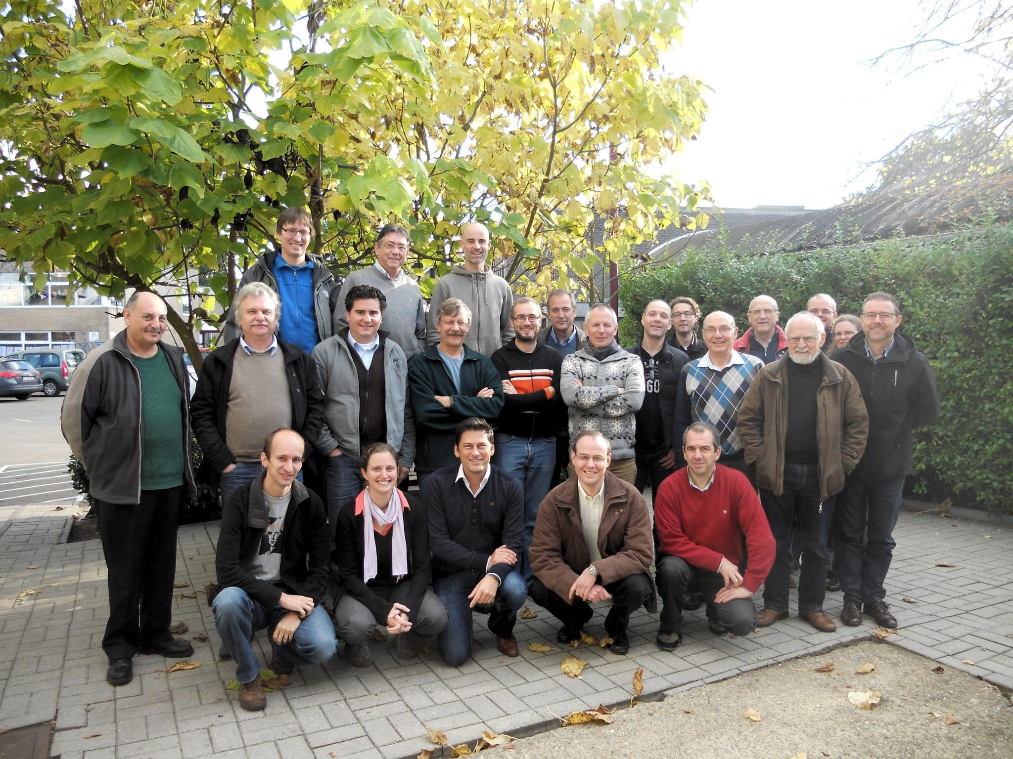
DeepskyLog - Who?

Slide 9
DeepskyLog - History
August 2003 : First ideas, astronomylog?
August 2004 : First lines of code
October 9, 2004 : First operational version
December 7, 2004 : Version 1.0
2005 : DeepskyLog 2.0, 2.1
2006 : DeepskyLog 2.2, 3.0
2007 : DeepskyLog 3.1
2008 : DeepskyLog 3.2
2009 : DeepskyLog 3.3, 3.4, 3.5, 3.6
2010 : DeepskyLog 3.7, 3.8, 3.9, 4.0, 4.1
2011 : DeepskyLog 4.2
2012 : DeepskyLog 4.3

Slide 10
DeepskyLog - History
Observations
09/11/2005 | 5000
28/05/2006 | 10000
16/12/2007 | 20000
10/04/2009 | 30000
14/03/2010 | 40000
08/04/2011 | 50000
30/05/2012 | 60000
27/02/2013 | 65000
08/05/2013 | 67304

Slide 11
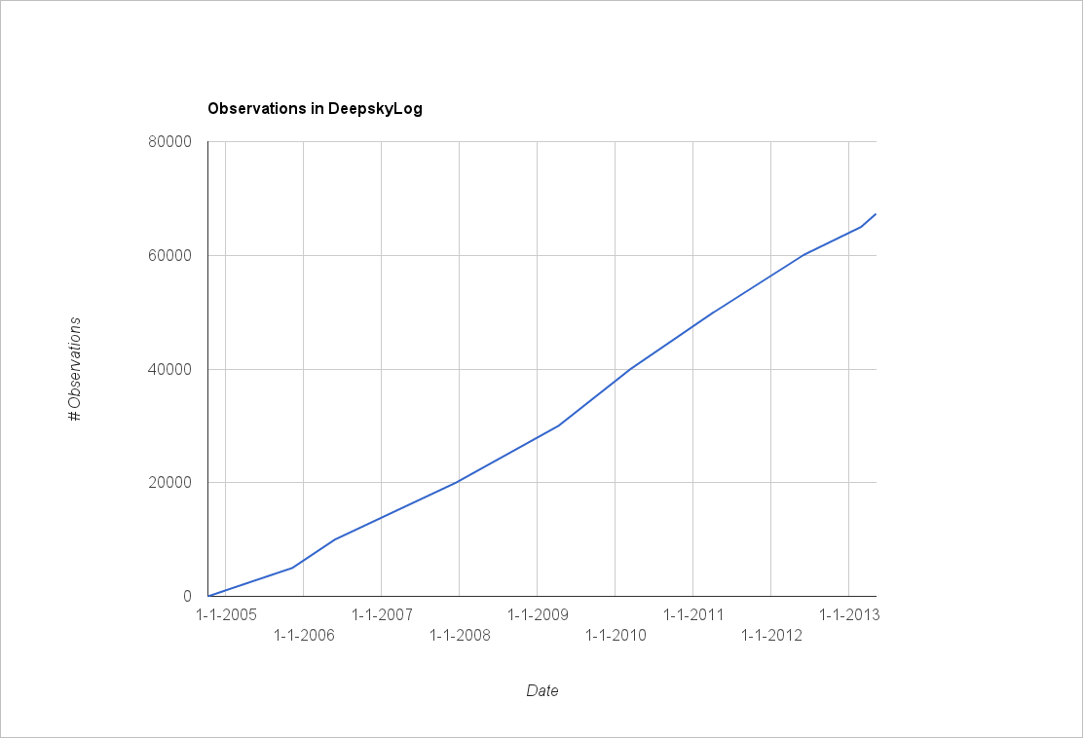
DeepskyLog - History

Slide 12
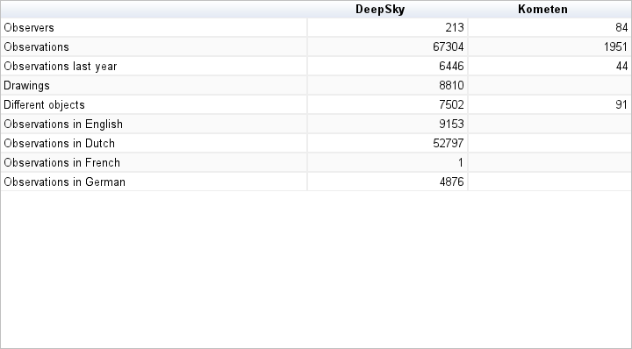
DeepskyLog - History

Slide 13
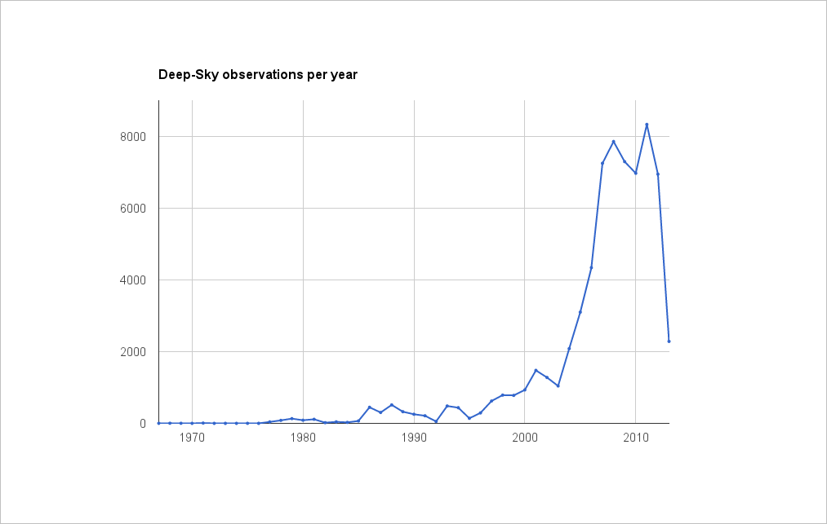
DeepskyLog - History

Slide 14
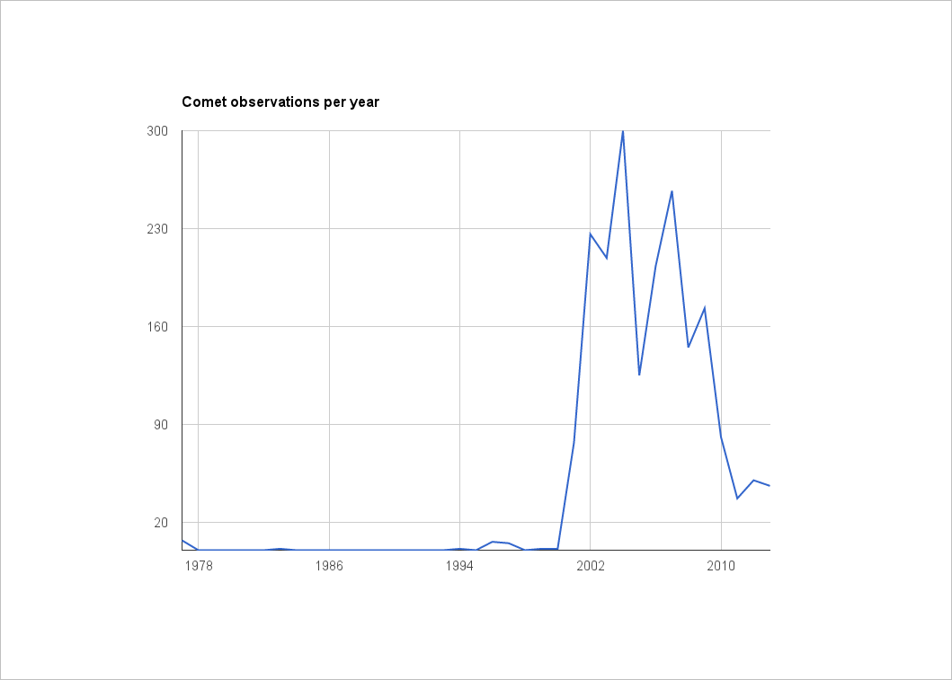
DeepskyLog - History

Slide 15
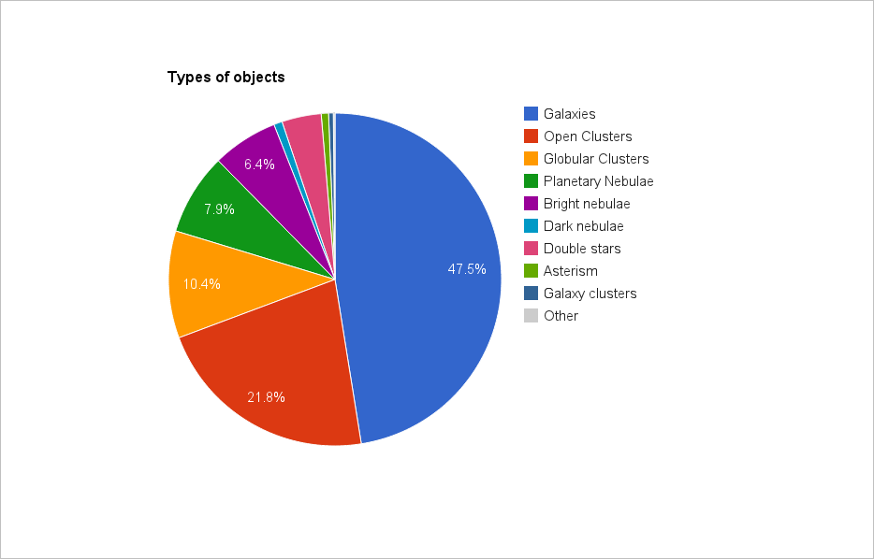
DeepskyLog - History

Slide 16
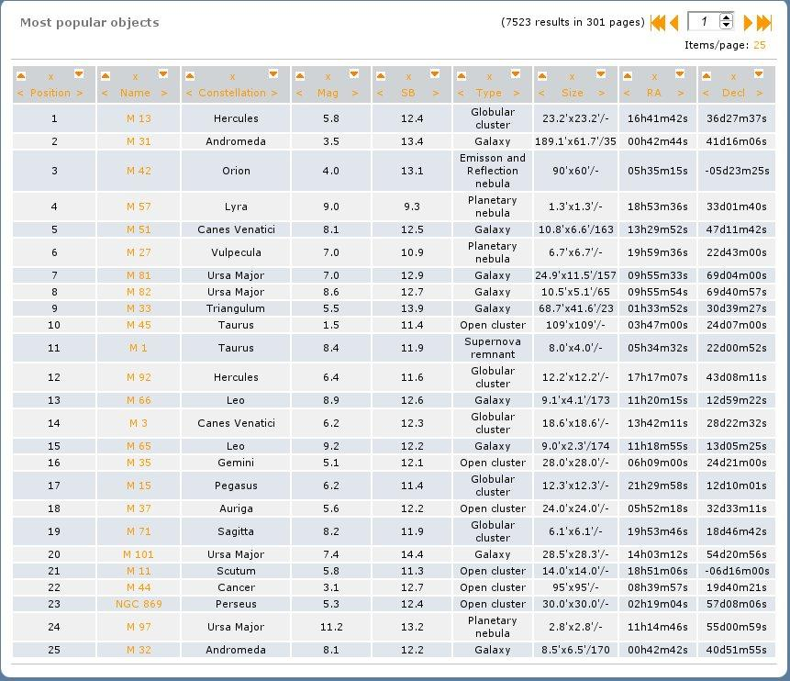

Slide 17
DeepskyLog 4.3
http://www.deepskylog.org/
http://www.deepskylog.be/
http://www.deepskylog.nl/
http://www.deepskylog.fr/
http://www.deepskylog.de/

Slide 18
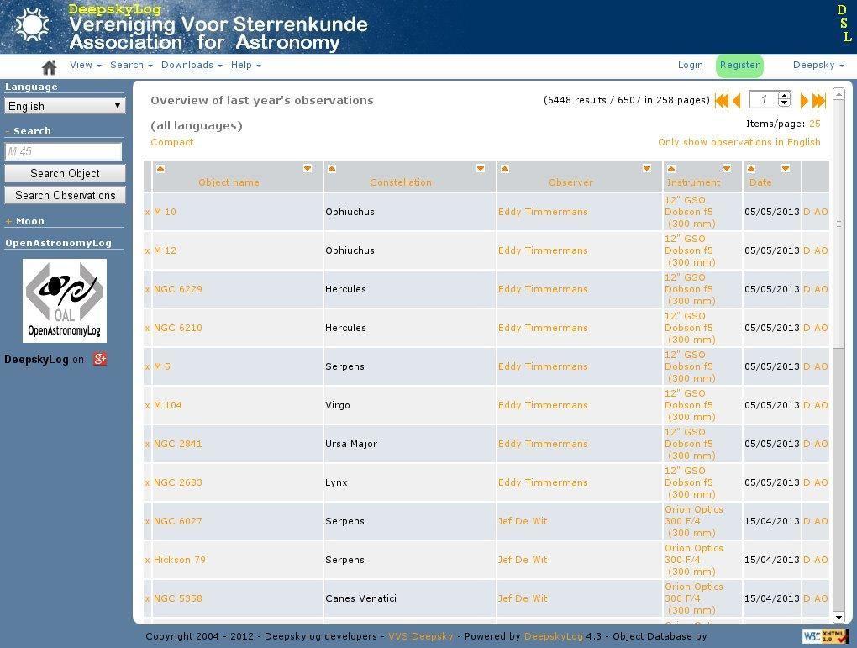

Slide 19
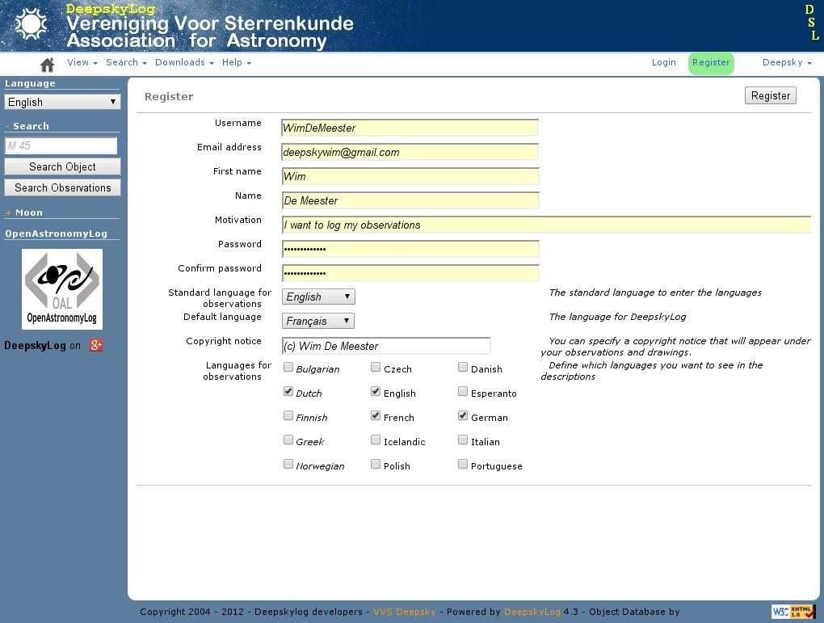

Slide 20
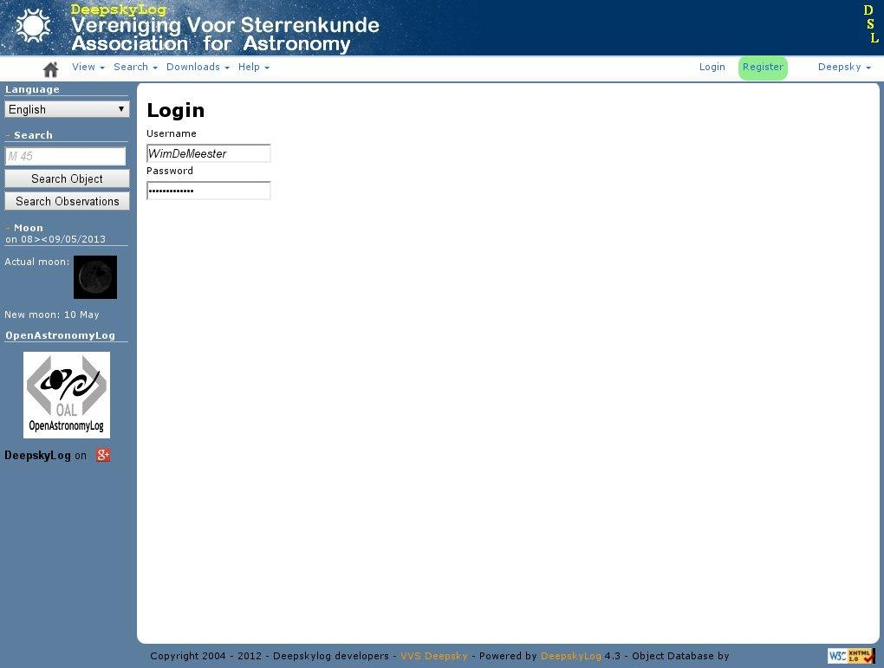

Slide 21
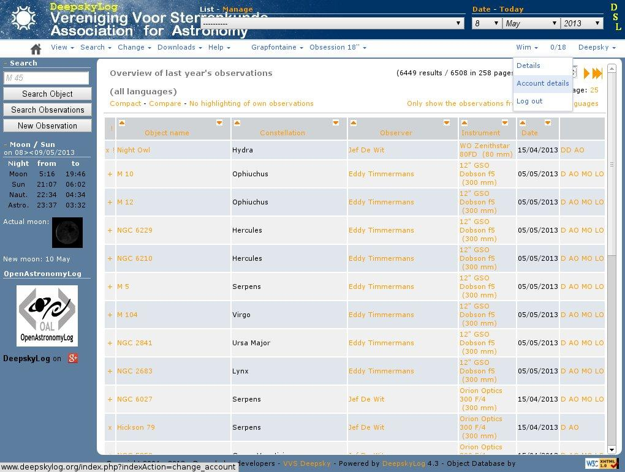

Slide 22
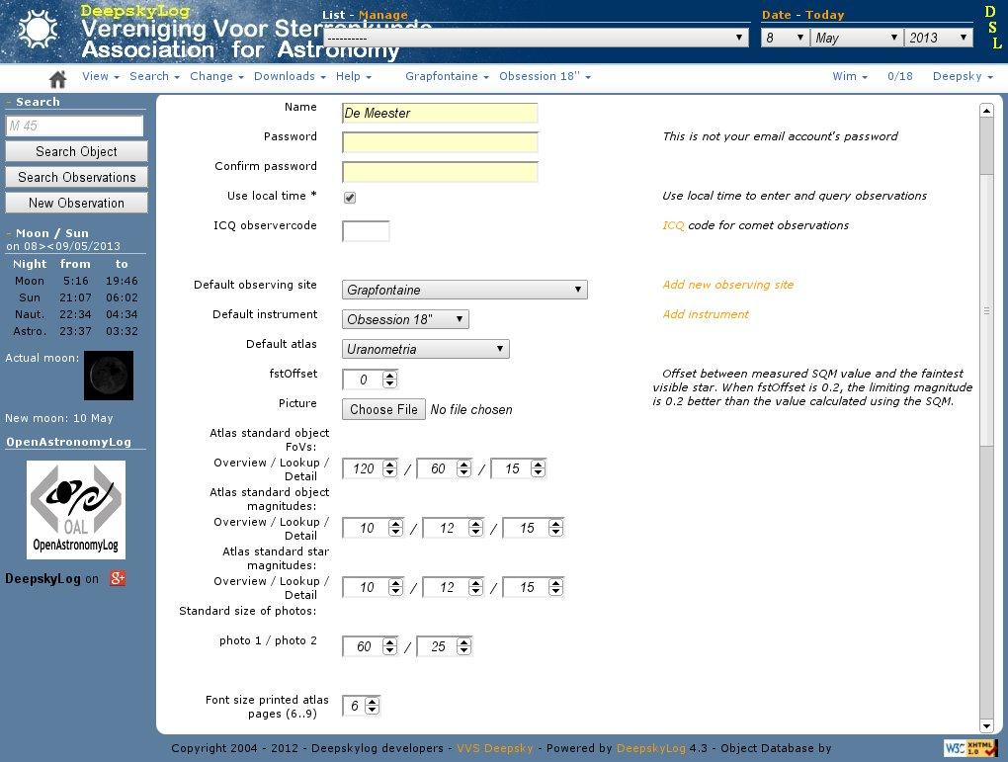

Slide 23
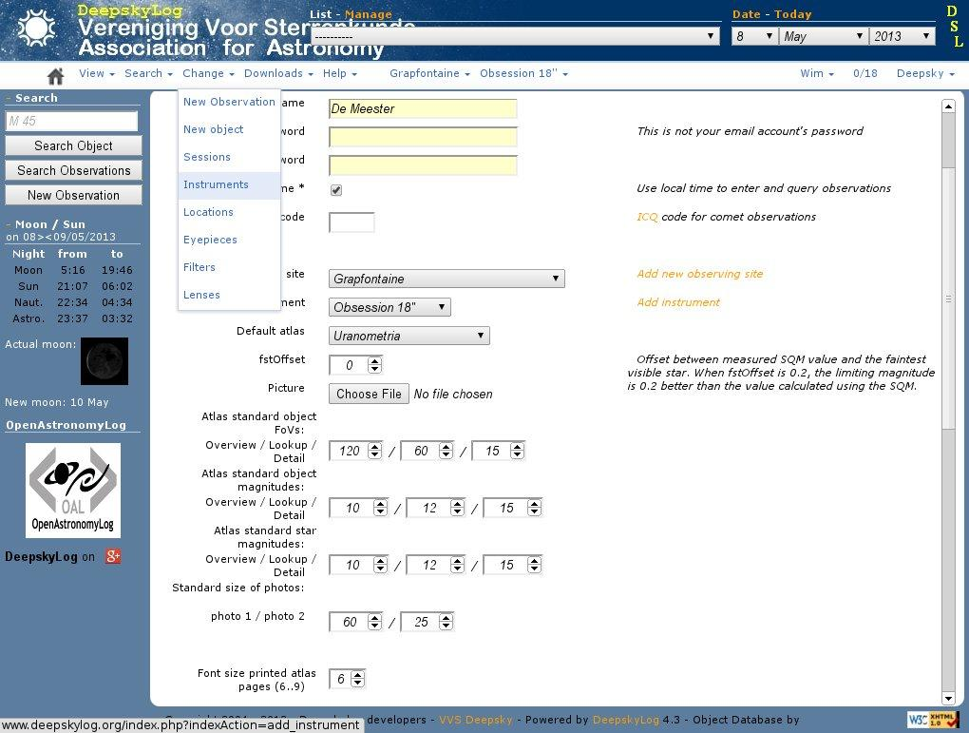

Slide 24
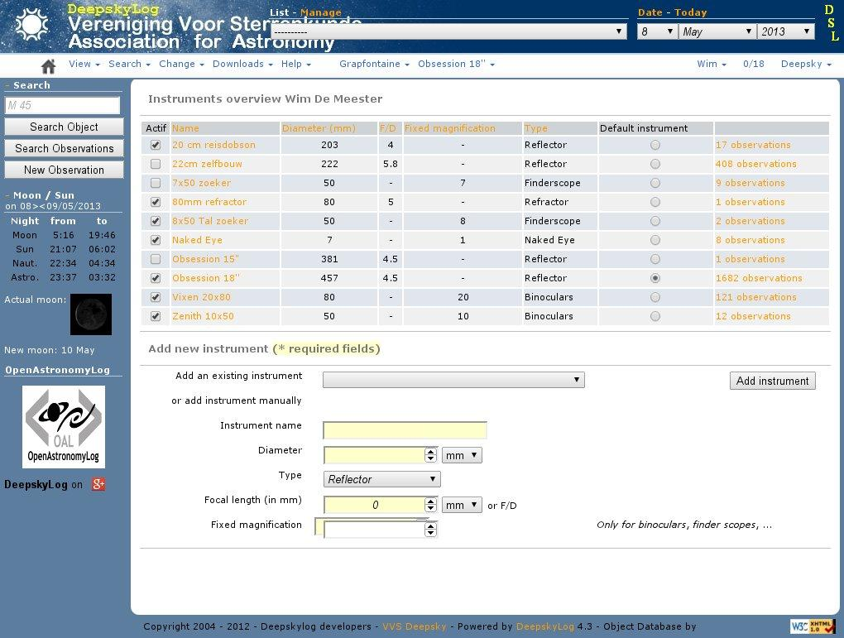

Slide 25
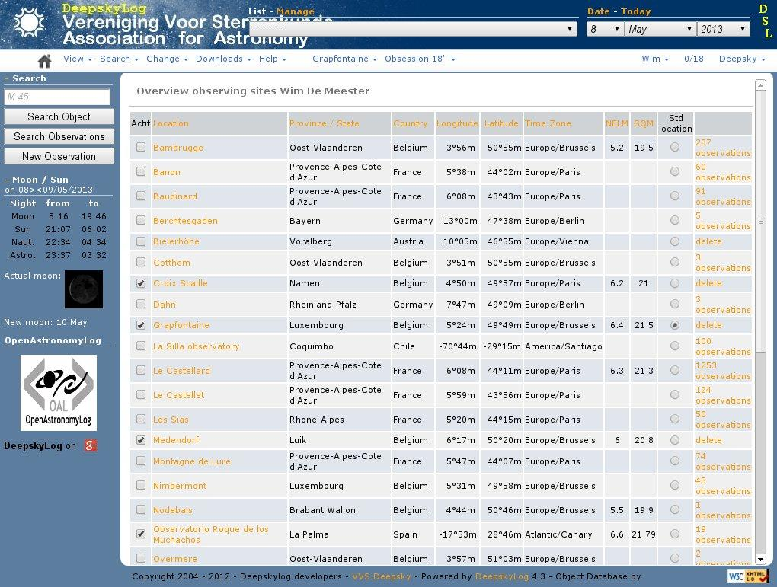

Slide 26
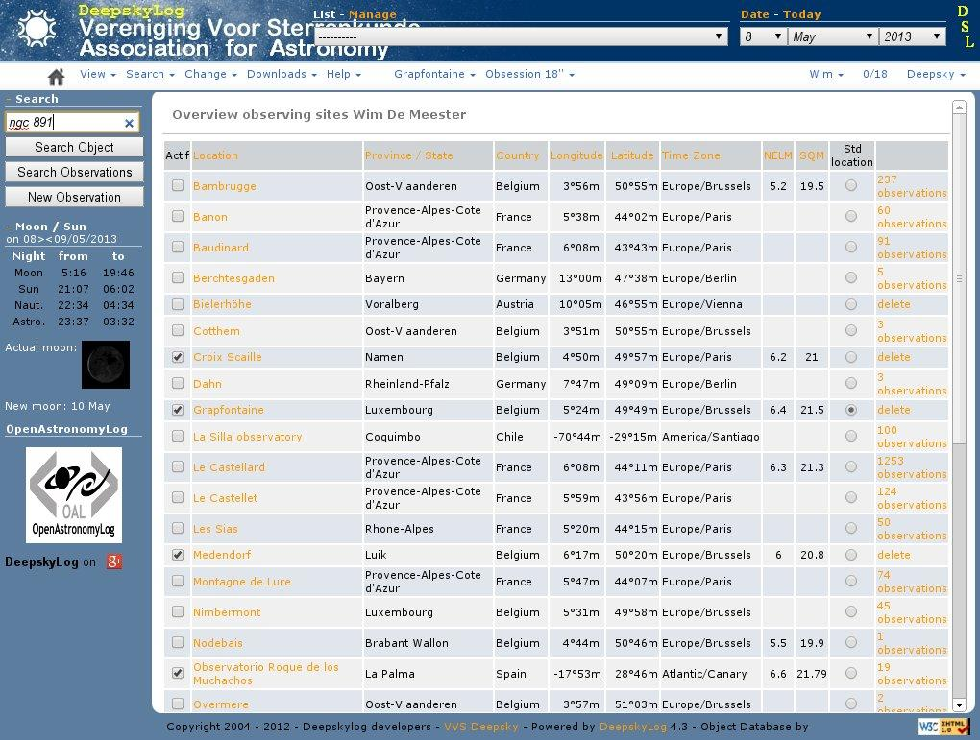

Slide 27
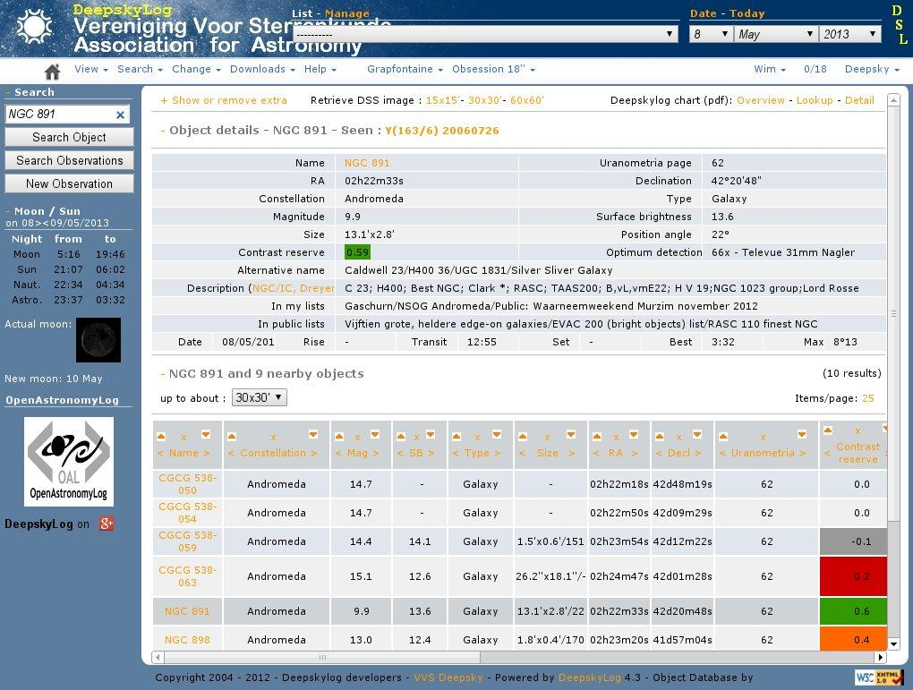

Slide 28
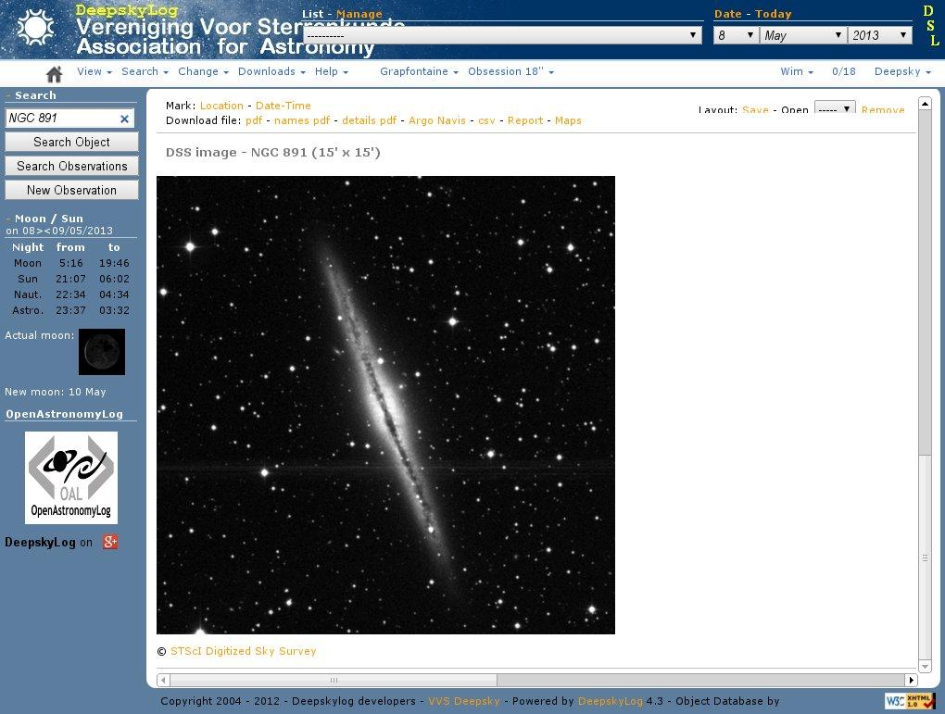

Slide 29
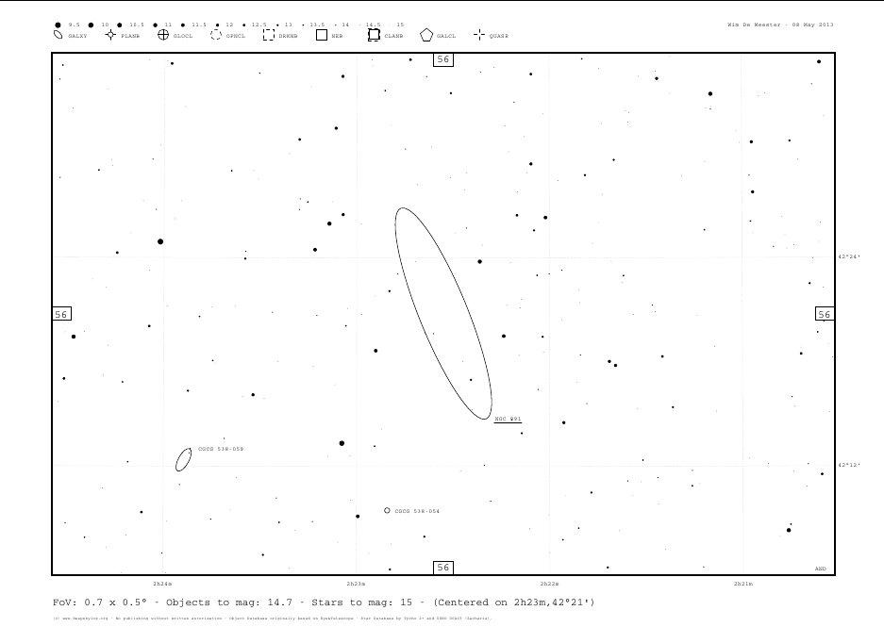

Slide 30
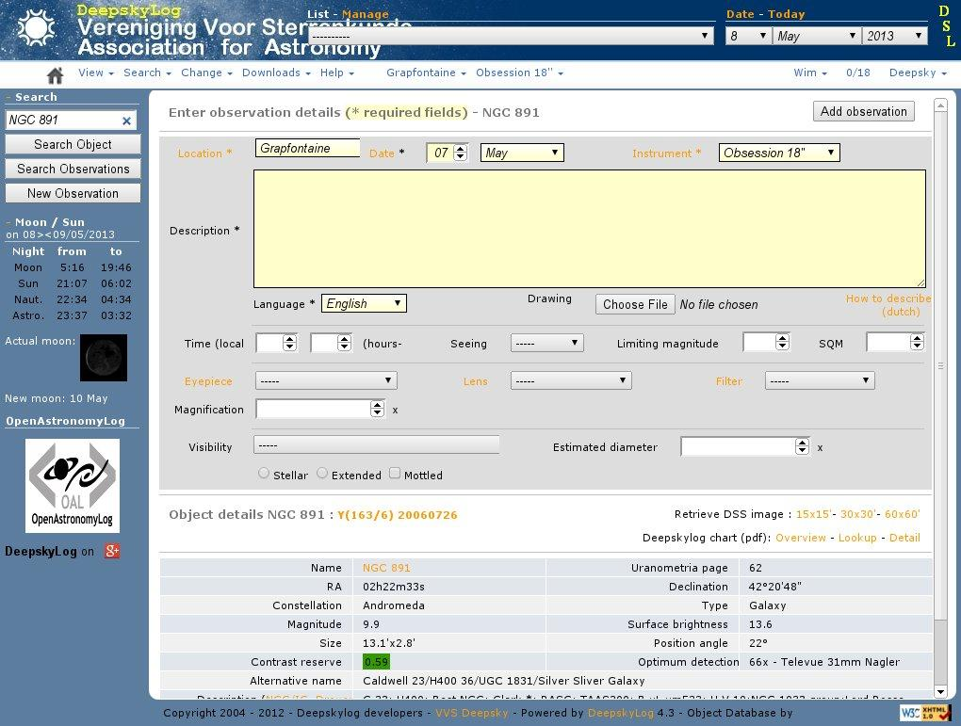

Slide 31
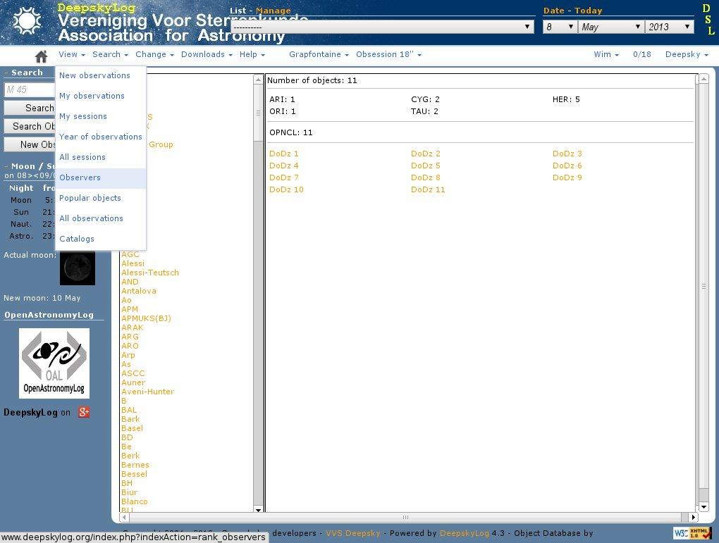

Slide 32
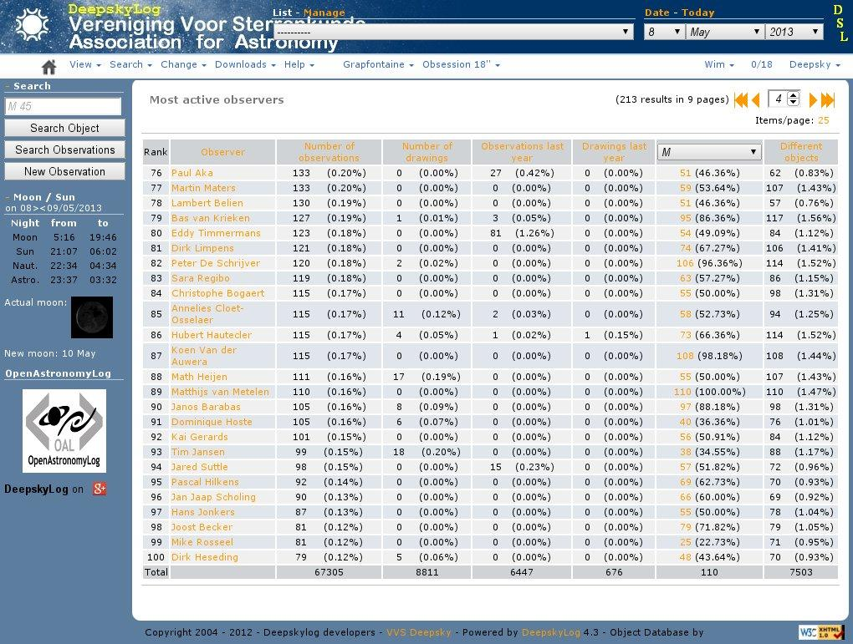

Slide 33
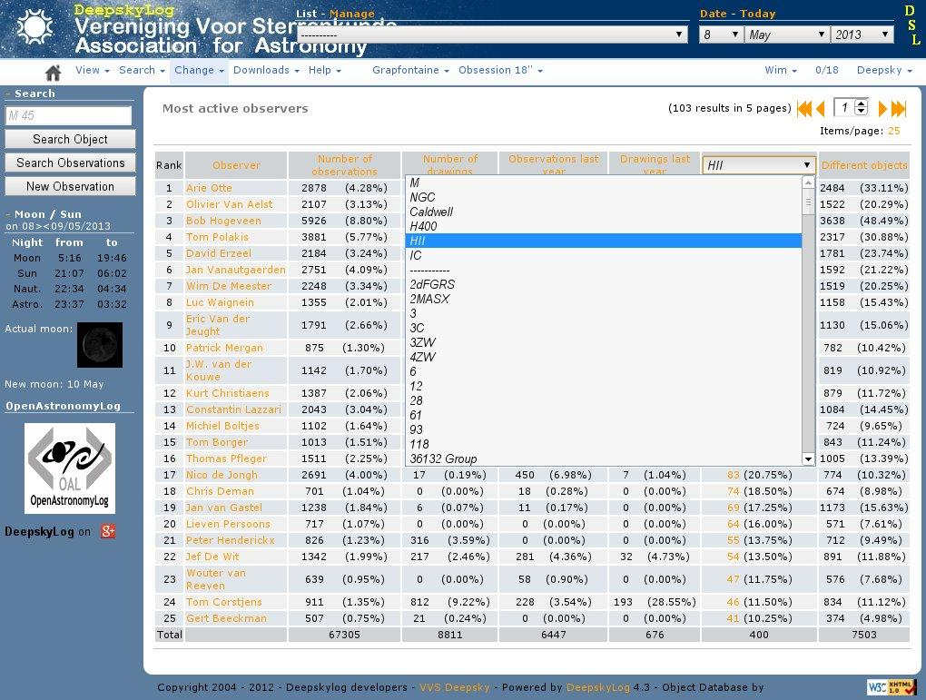

Slide 34
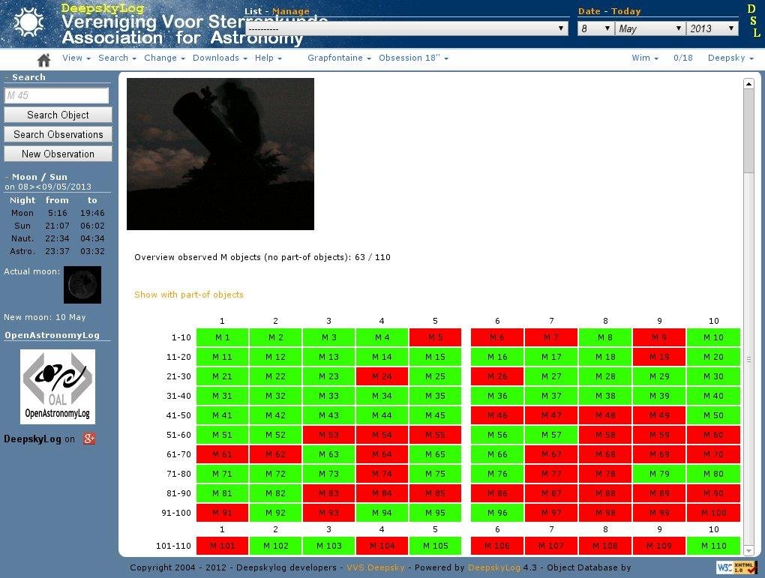

Slide 35
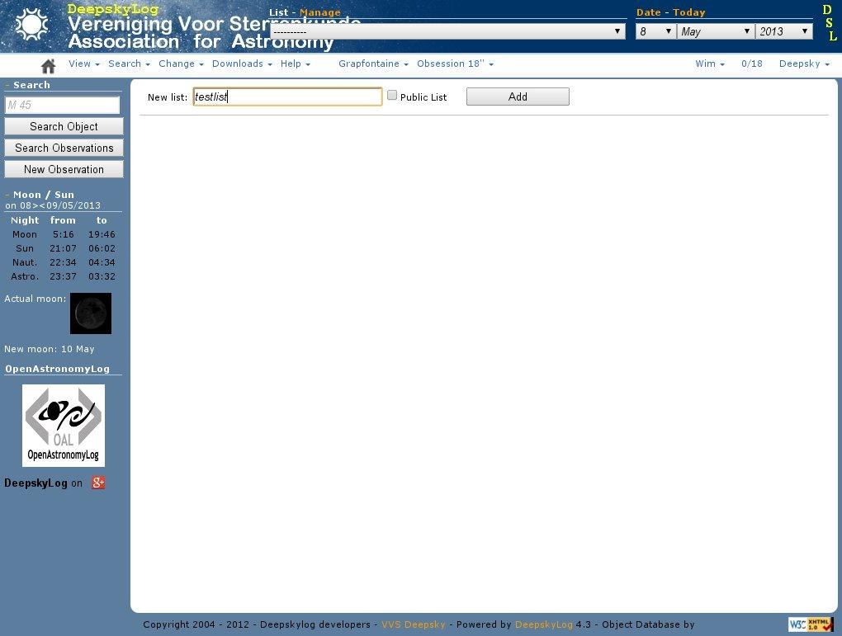

Slide 36
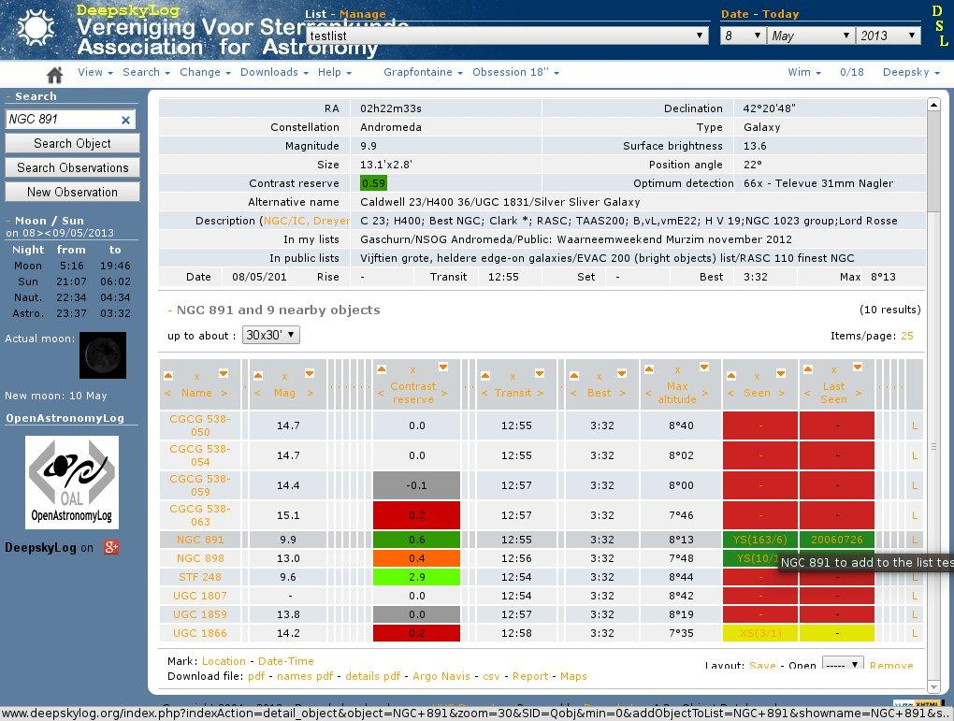

Slide 37
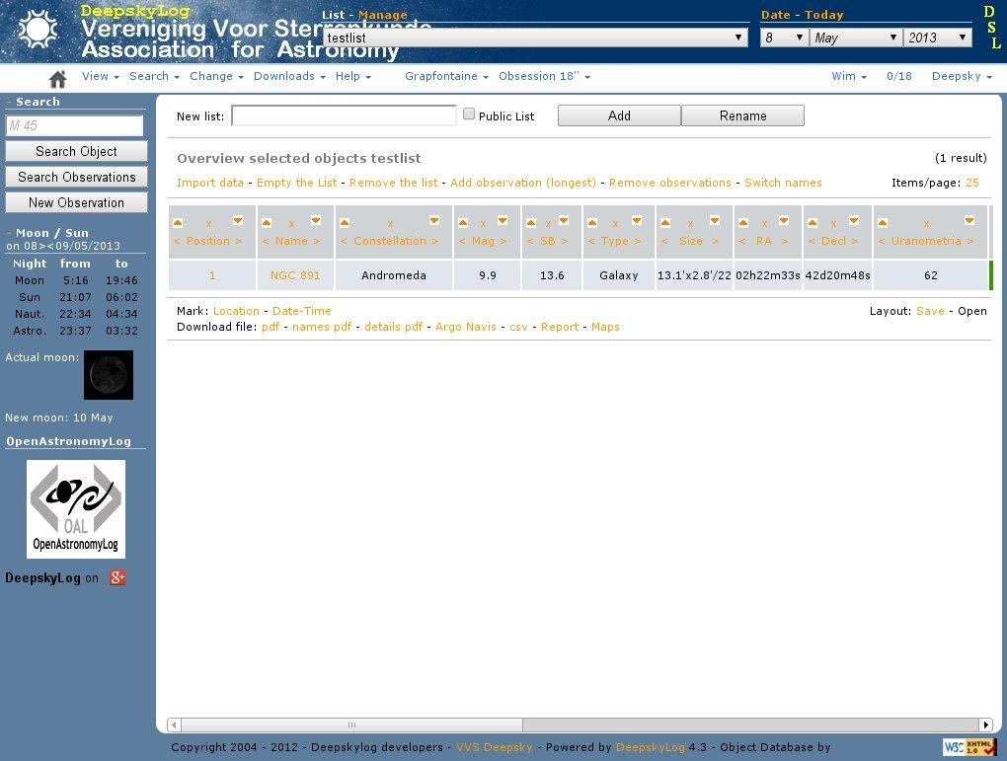

Slide 38
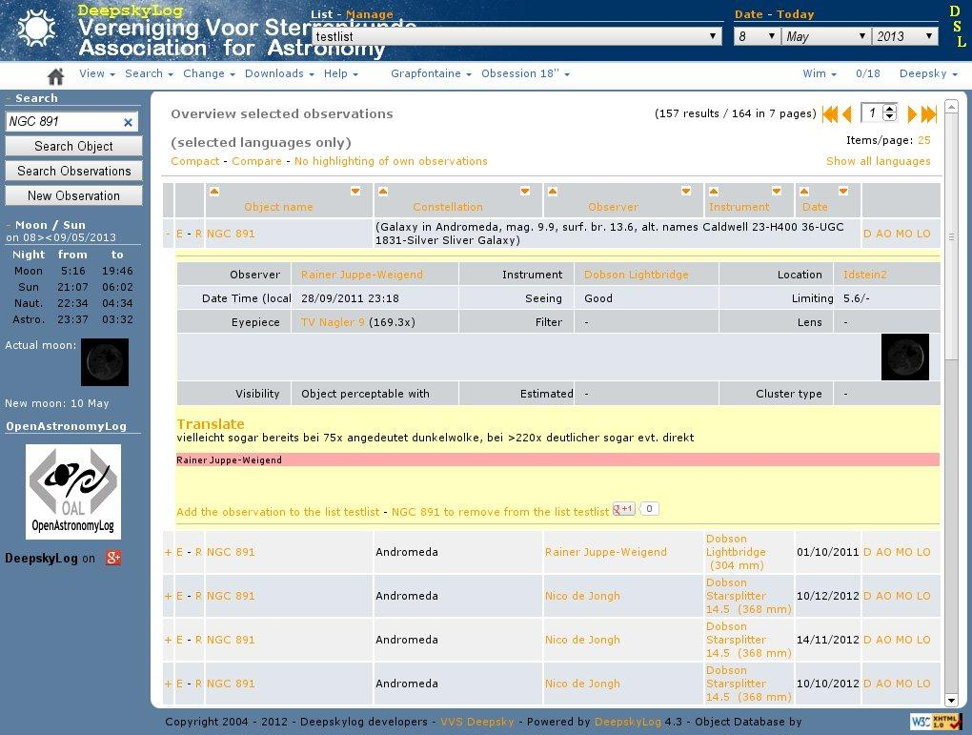

Slide 39
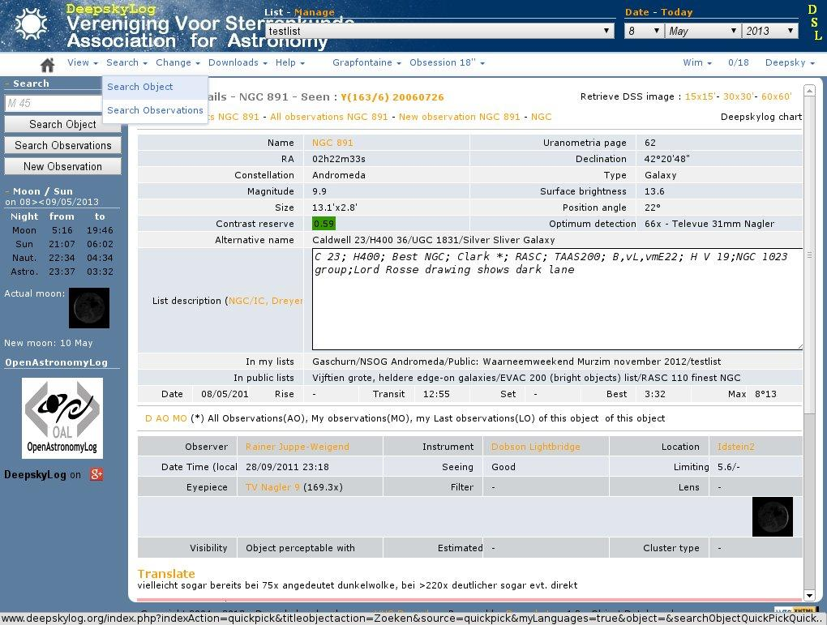

Slide 40
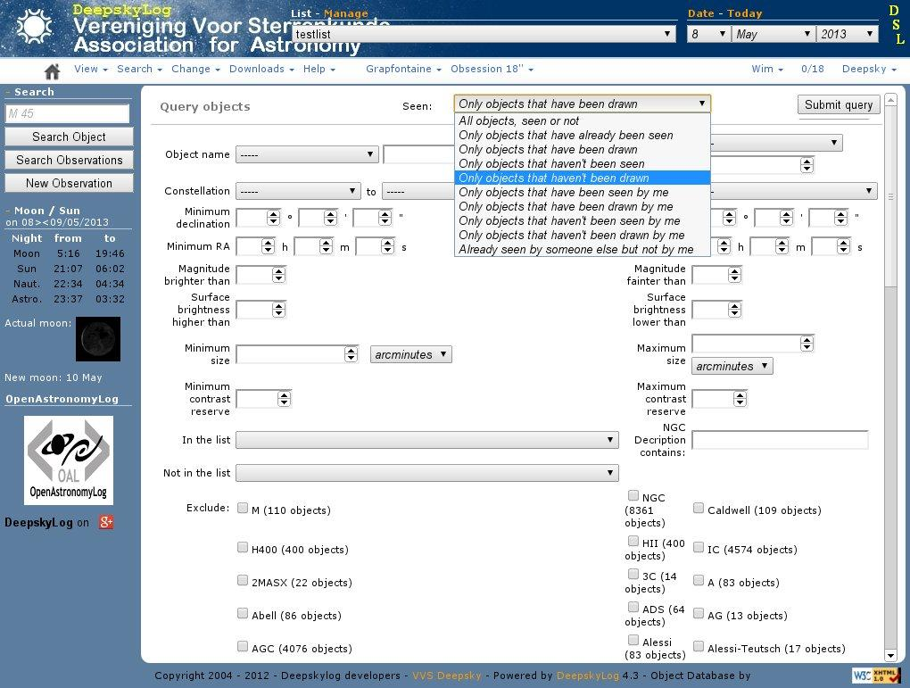

Slide 41
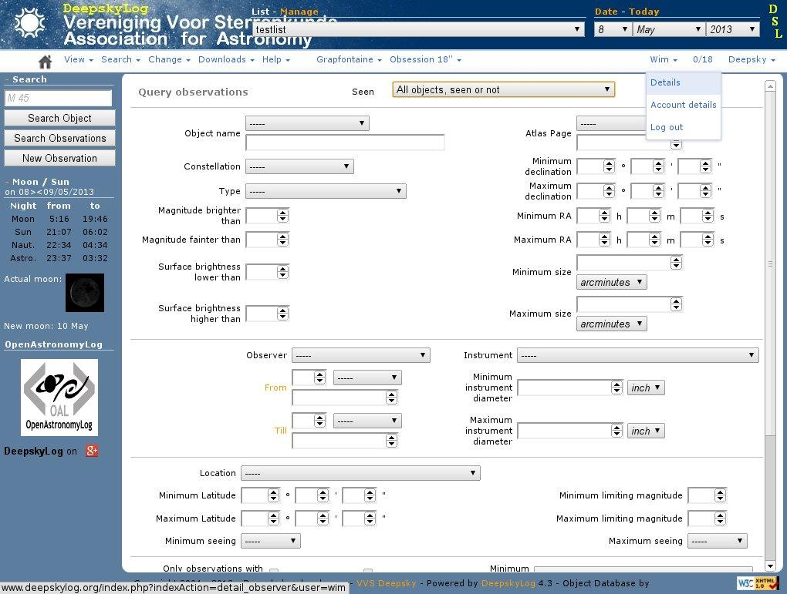

Slide 42
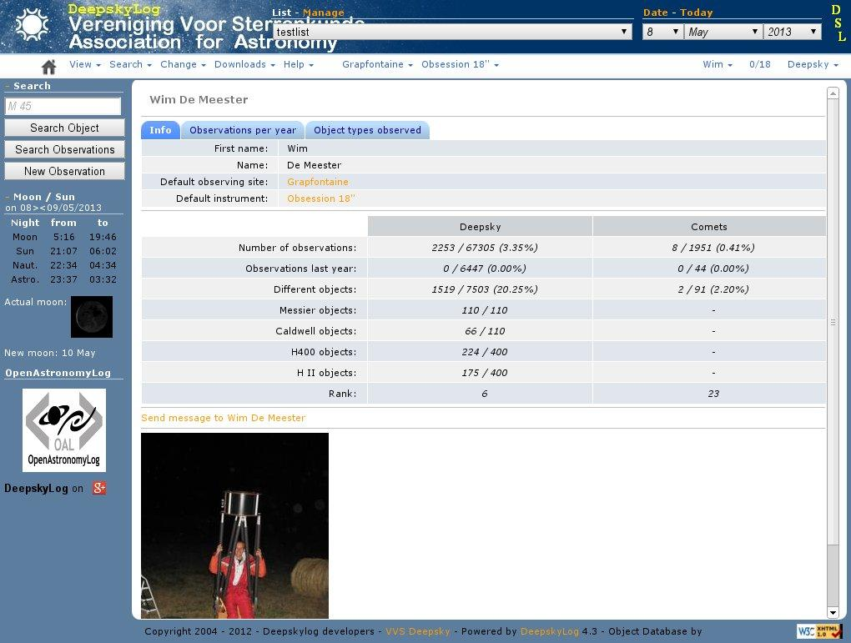

Slide 43
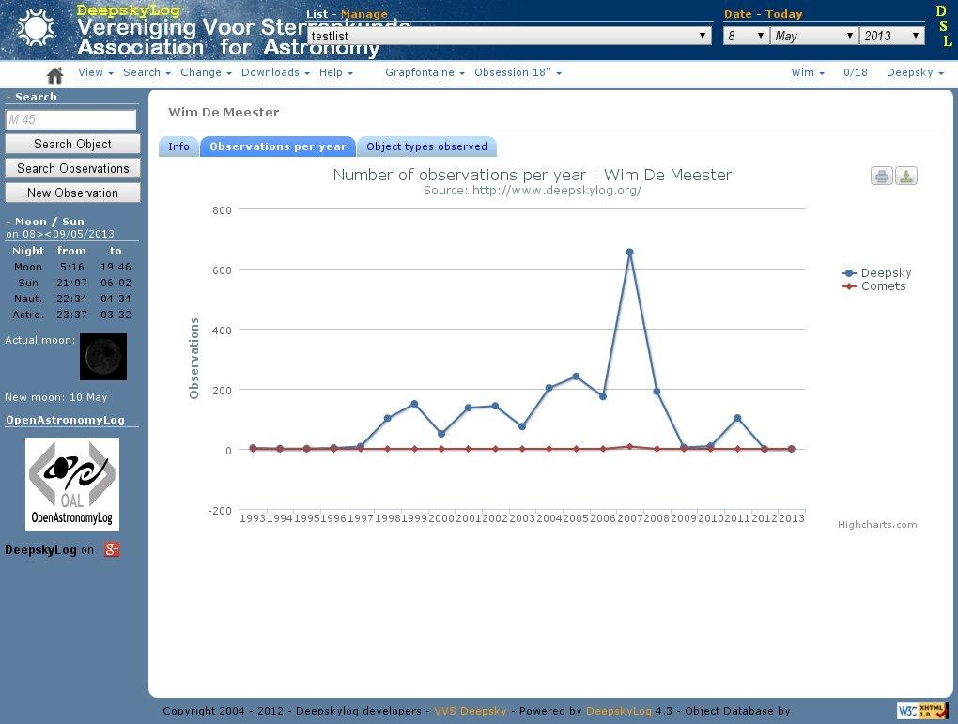

Slide 44
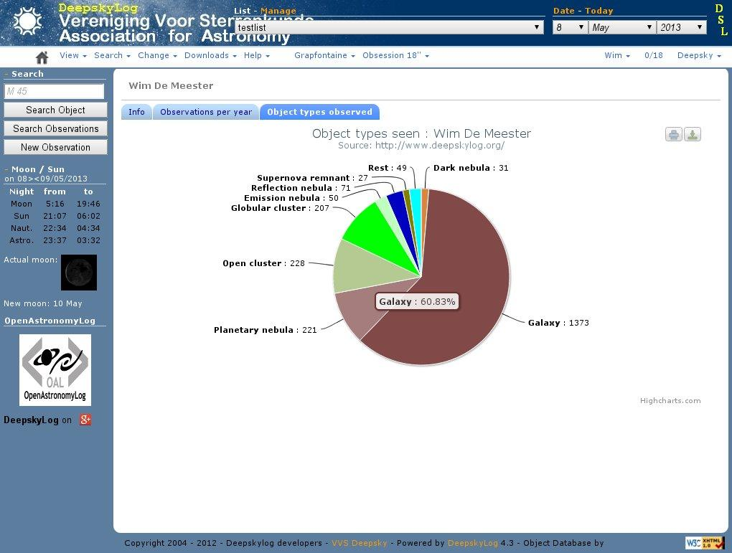

Slide 45
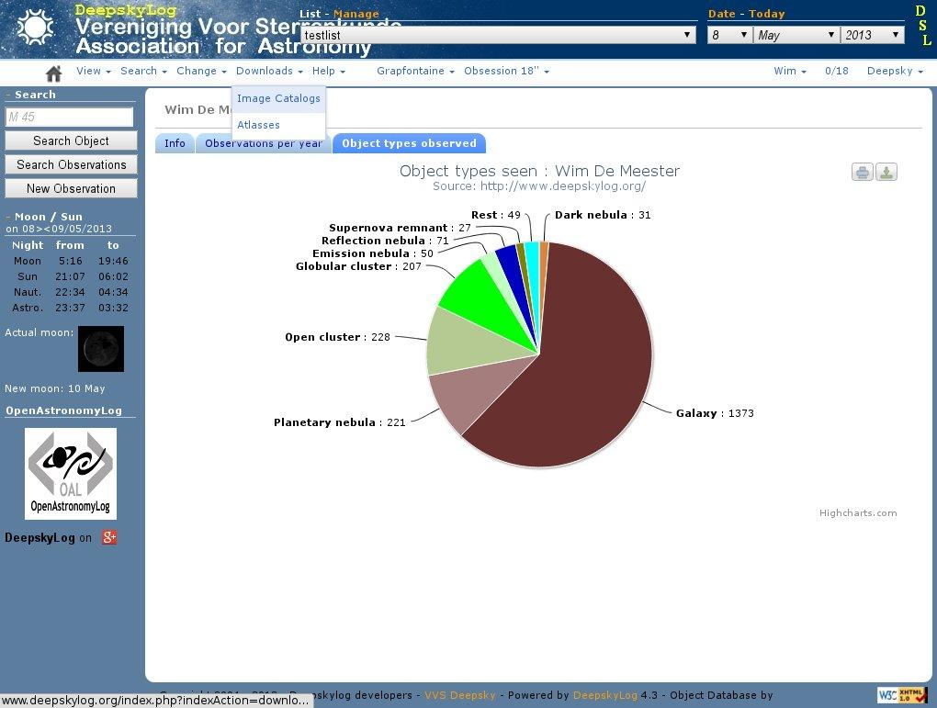

Slide 46
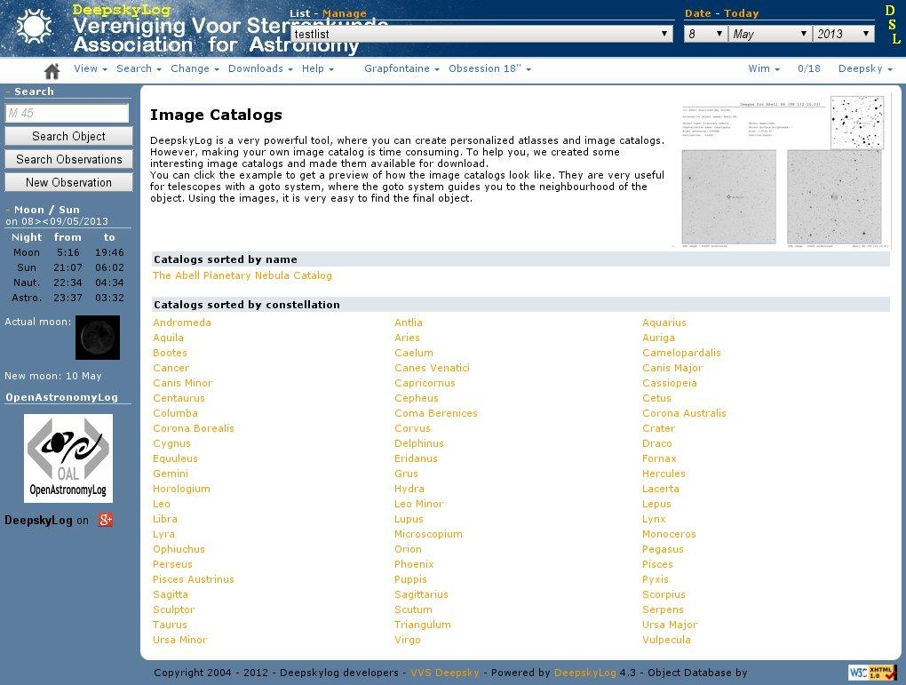

Slide 47
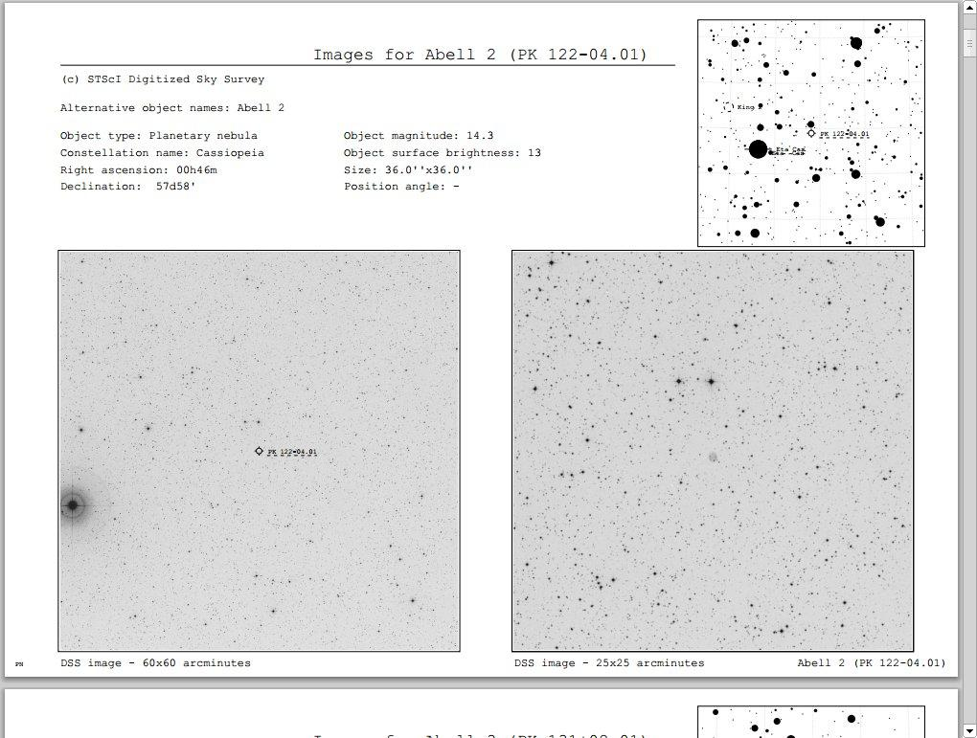

Slide 48
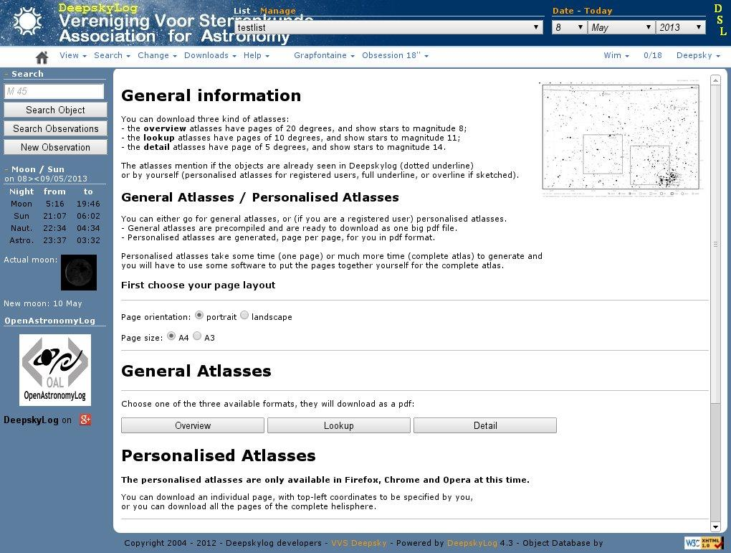

Slide 49
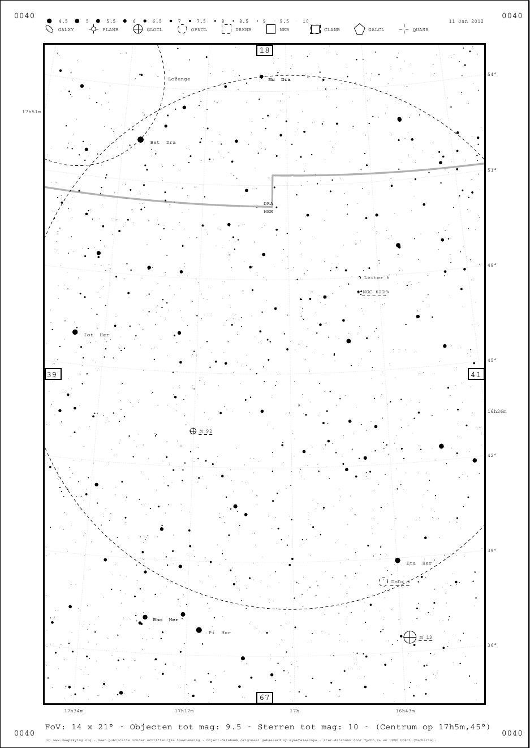

Slide 50
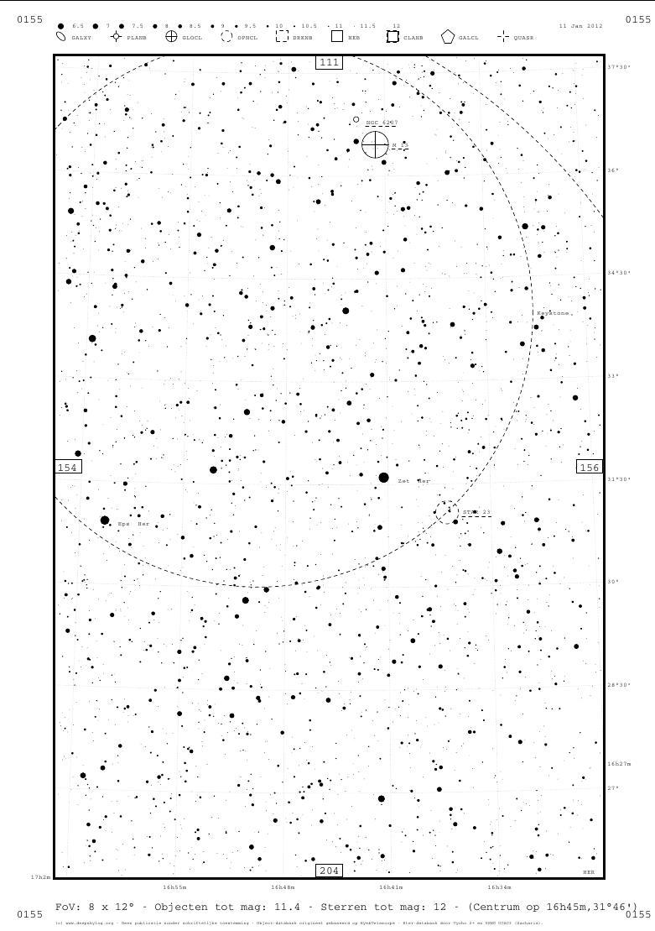

Slide 51
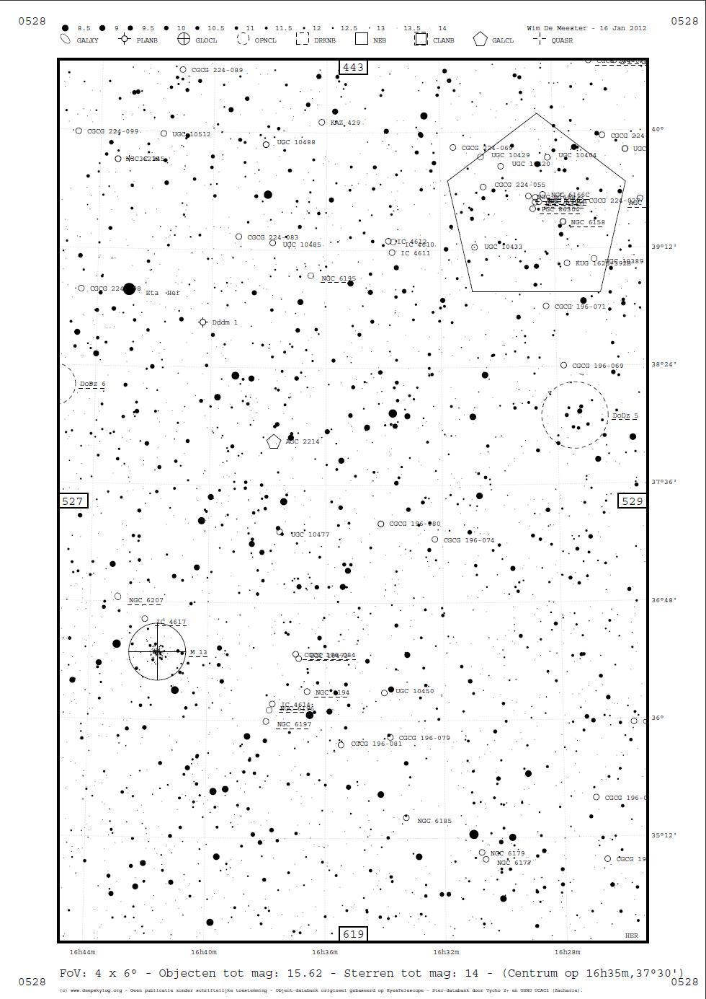

Slide 52
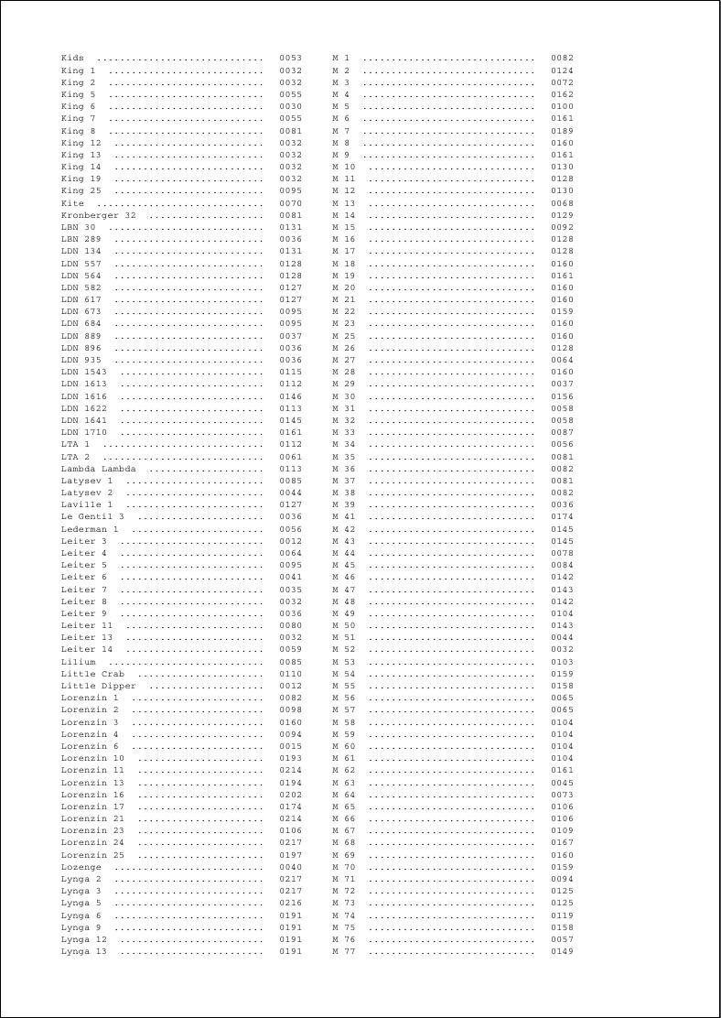

Slide 53
DeepskyLog
Help DeepskyLog!
Database
Documentation
Articles
Social media : Facebook, youtube, google+
Developing
Translations
Bugs

Slide 54

developers@deepskylog.be
deepskywim@gmail.com

